Slide 1
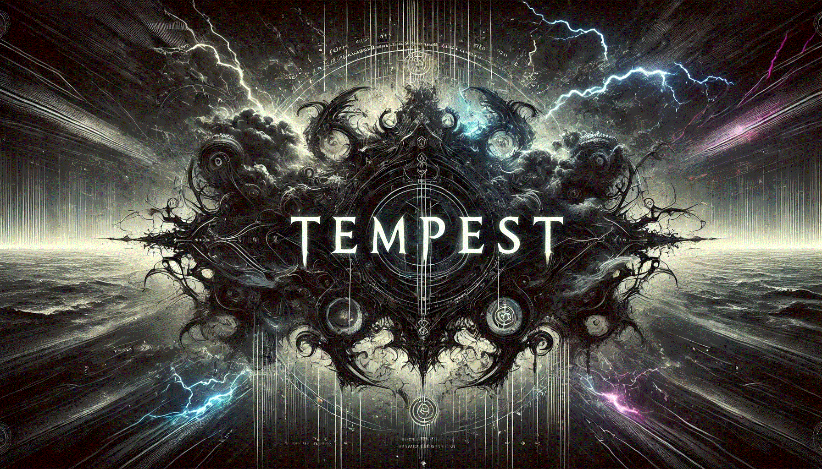
Command and Control Framework

Slide 2
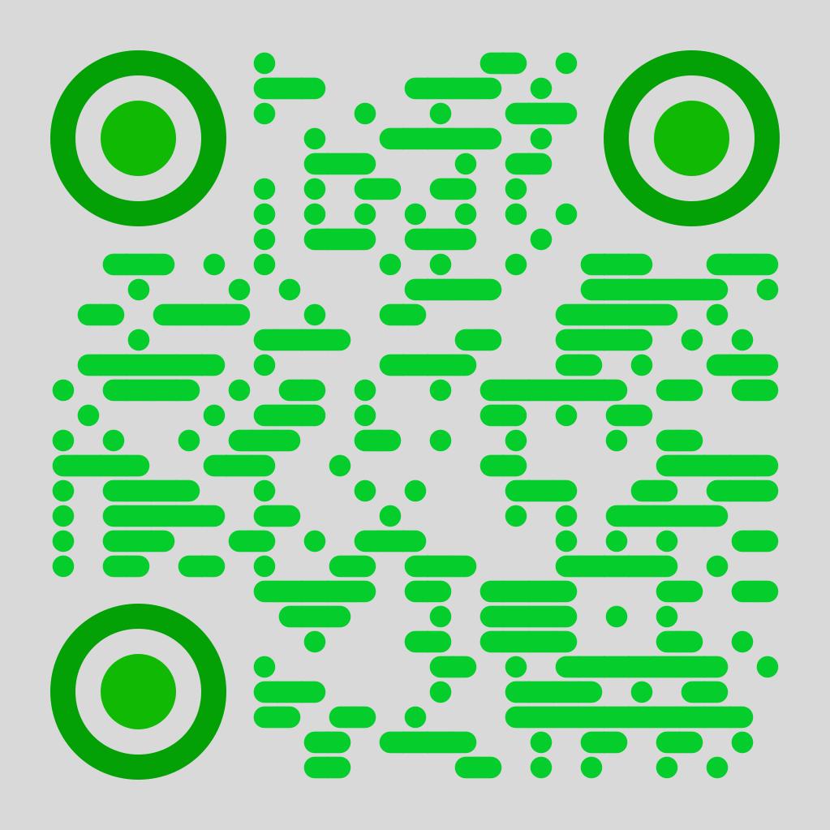
whoami
Kirk Trychel
Specialties:
Adversary emulation/simulation, malware dev, AI red team
US DoD
Secureworks
CrowdStrike
AWS
Box
X: @teach2breach
Web: https://teach2breach.io
Github: https://github.com/Teach2Breach
X

Slide 3
TEMPEST C2 DESIGN THEORY
Design should be “simplistic” yet highly effective and reliable.
Make our implant look like a typical application.
Hacker friendly interface.
Easy to deploy. Easy to use.
Implant variants. Modular design.
100% Rust
Keep it simple.

Slide 4
Initial Design
HTTPS callbacks
Server hosts 2 sets of API endpoints, on 2 separate “servers”.
APIs for implants (default port 443)
APIs for operators (default port 8443)
Make things functional first. Obscure / evade 2nd.
Simple design theory. Look like any normal application making API calls.
Whole project started with a single API callback.

Slide 5
Components 100% rust
Tempest (Full Framework)
Anvil (c2 server)
HTTPS servers, API endpoints
Sqlite db (rusqlite)
Internal functions
Conduit (hacker client)
Terminal User Interface (TUI)
Cross-platform
Imps (implants/beacons)
Multi-platform
Modular
Variants

Slide 6
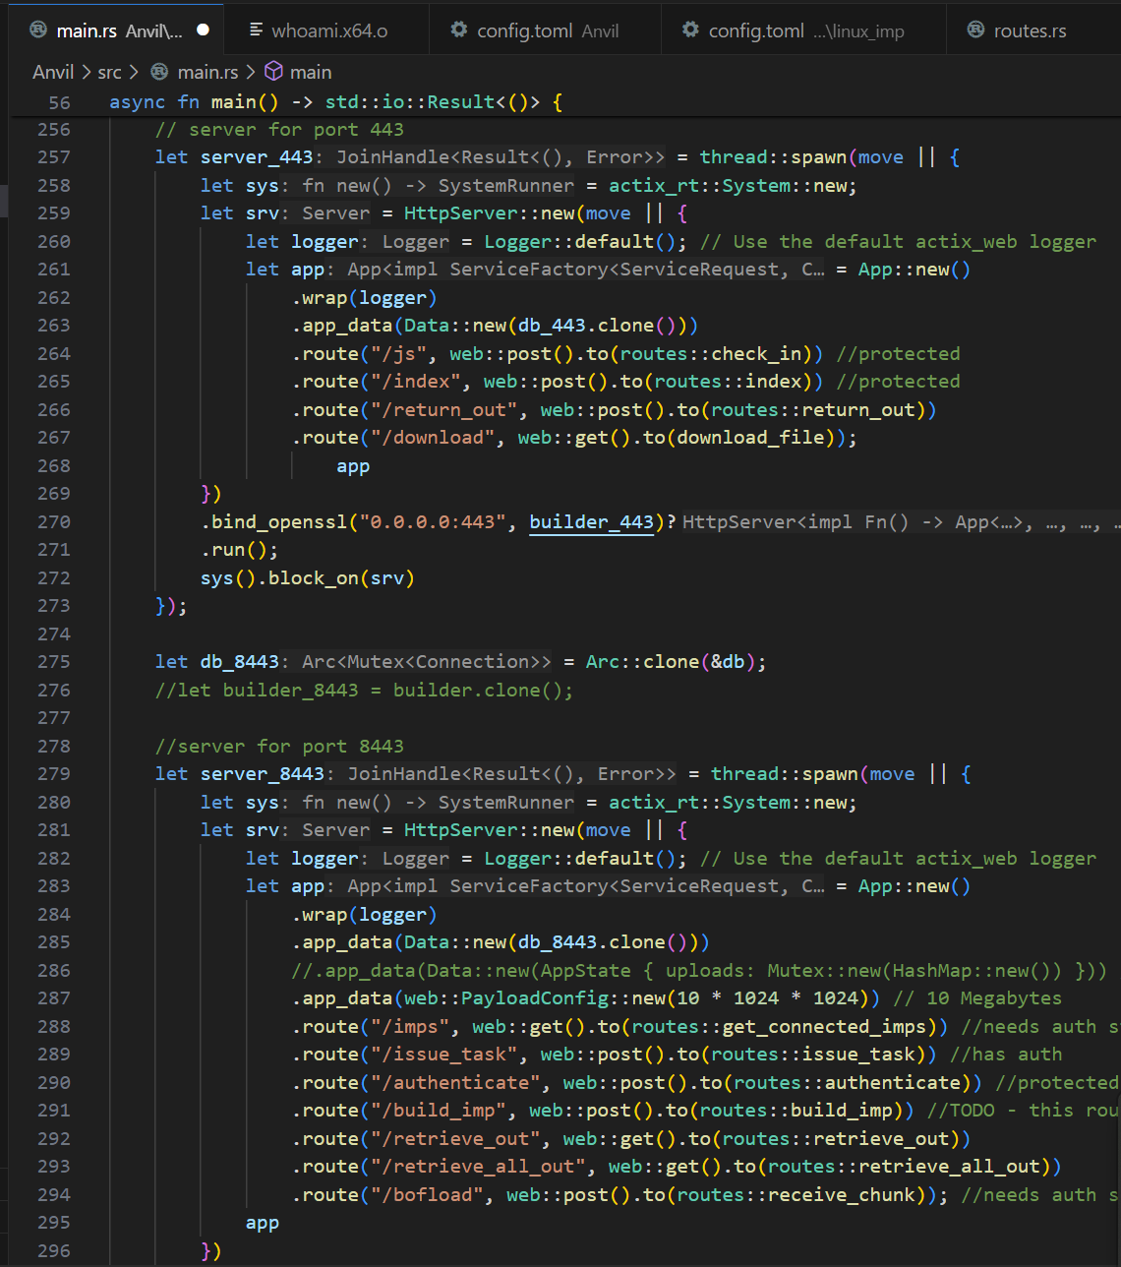
Technical Specs
ANVIL – command and control server
2 sets of APIs on 2 virtual servers, on separate ports.
Actix.rs and Tokio (async)
Openssl
Backend local-only SQLite database
Rusqlite
Store implant information
Store tasks for retrieval
Store output for retrieval

Slide 7
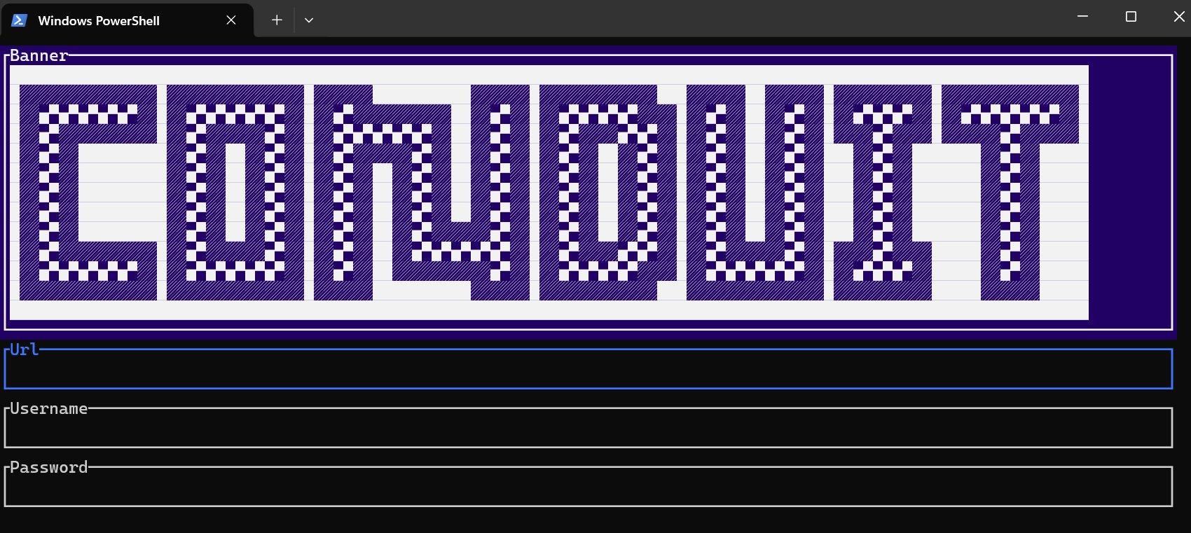
Technical Specs
CONDUIT hacker client
Authentication
Cross platform!
Terminal User Interface (TUI)
ratatui
Completely in your terminal
Dashboard updates in real-time
Fully scrollable
All you ever need, nothing you don’t
Hacker cool factor ++
Impress your nerd friends

Slide 8
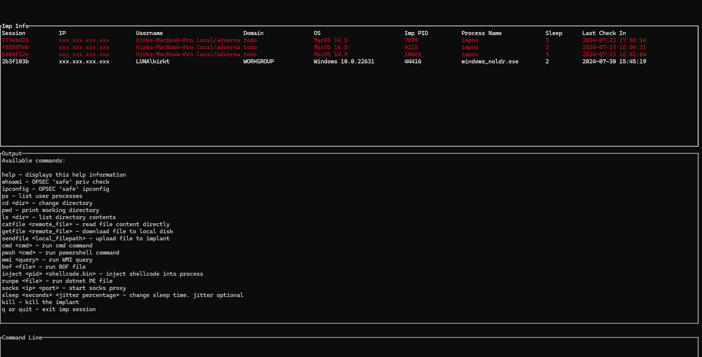
Technical Specs

Slide 10
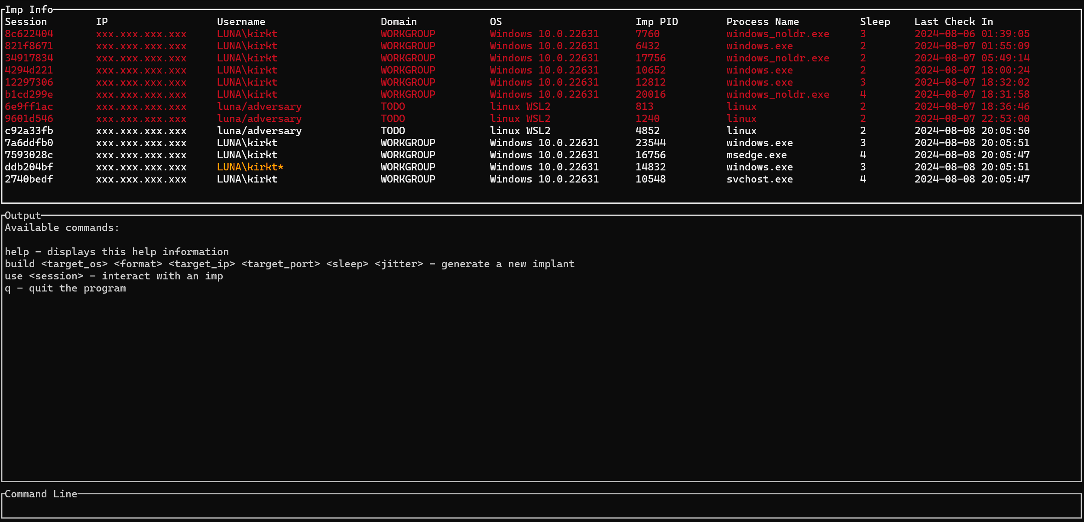
Demo Gif

Slide 11
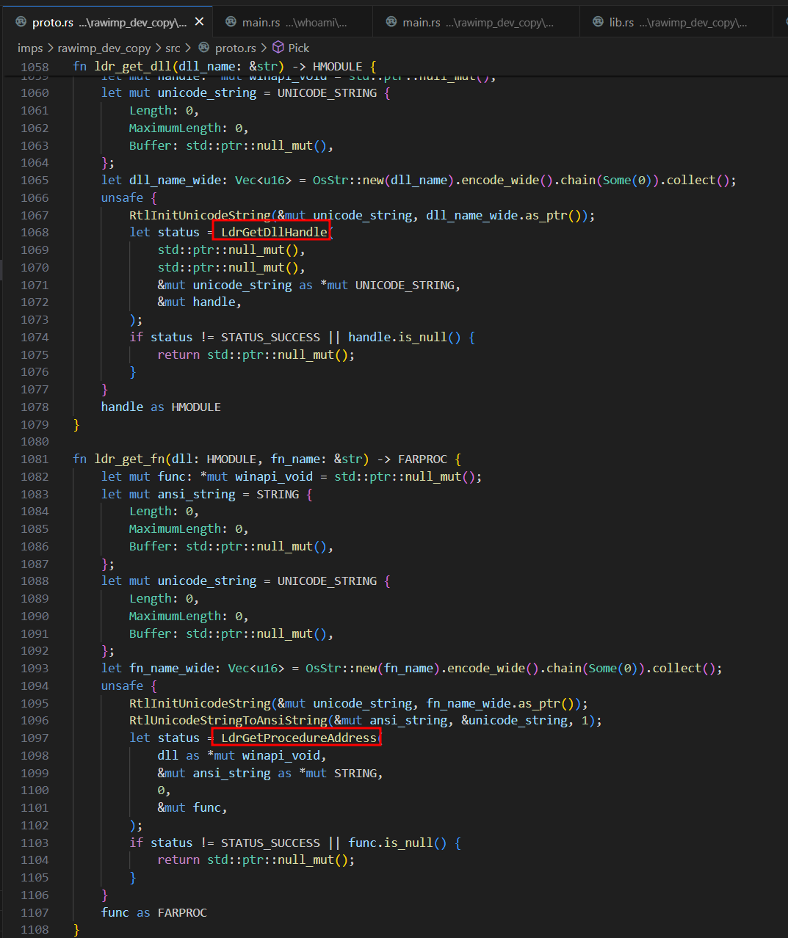
Technical Specs
Implants (Imps)
Windows
Dynamically located API function calls OR
Custom TEB/PEB walk to locate function addresses
Custom HTTPS handlers (not reqwest or hyper)
Modern modules
Bof/coff loader (Cobalt strike bof compatible)
Socks5 proxy
evasive process injections
OPSEC focused. Just what you need, nothing you don’t.
Gen exe, dll, shellcode. sRDI compatible
Linux
Same basic design as Windows imps
Mac
Prototype agent (WIP)

Slide 12
Advanced Features
BOF loader
Load beacon object files in-memory, compatible with CS BOFs
.NET executable in-memory loader.
Inline, no fork and run
Socks proxy (locked down to the server localhost)
TEB/PEB walker to locate Windows API function addresses
Custom dynamic API loader
String encryption
Modular build layout (mods as Rust crates)
Shellcode generation
Custom WMI engine
Process Injection

Slide 13
Using Tempest Effectively
Generate shellcode and Bring Your Own Dropper (BYOD)
MacropackPro / ShellcodePack / Scarecrow / RustPack etc…
Start with a high sleep timer (60 seconds). Never drop sleep to below a few seconds.
Don’t use cmd or powershell except in testing. At least use WMI or an OPSEC safe module.
Establish multiple implants. Inject remote processes. Use Multiple C2s. (stage1 & stage2)
Remove obvious IOCs. Remove unneeded modules. Customize!
Think through every action, “What telemetry will be generated? What might a defender think if they see that data? If I get burned, how much time do I have?”

Slide 14
Tempest Build System

Slide 15
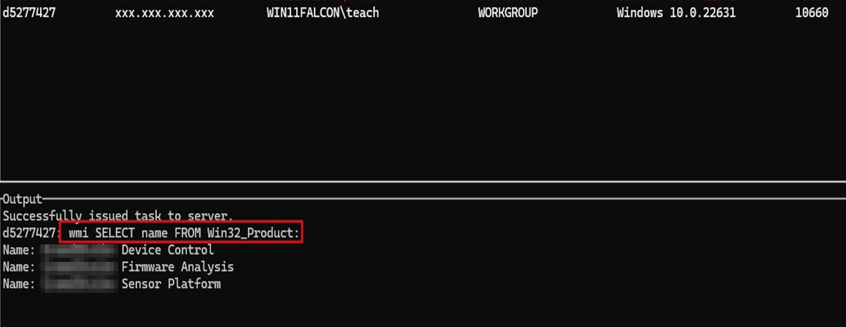
WMI module – run arbitrary WMI queries

Slide 16
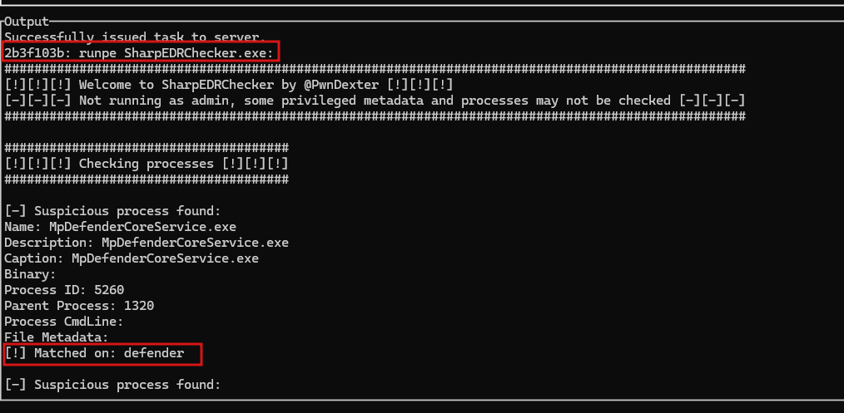
runpe – Load .NET executables in memory

Slide 17
BOF loader – load object files in memory
https://github.com/trustedsec/CS-Situational-Awareness-BOF/tree/master/SA

Slide 18
inject – remote process injection
https://github.com/FuzzySecurity/Sharp-Suite/blob/master/UrbanBishop

Slide 19
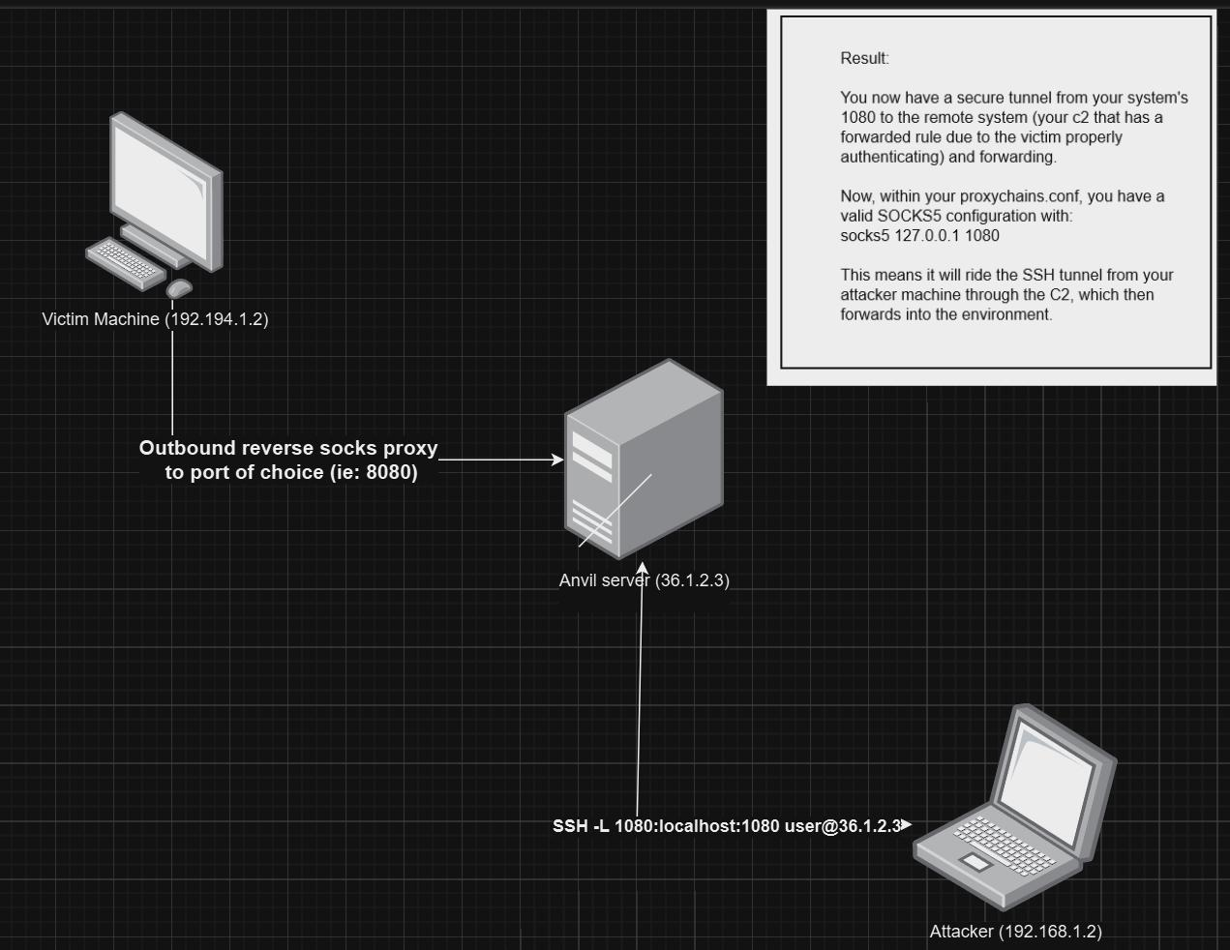
Safer socks – only available “locally”

Slide 20
ROADMAP && Notes
SSH key authentication for operators
Additional configuration available to operators, less hardcoded config
Alternative callback comms (websockets / peer to peer implants)
Additional custom post-ex modules (cred harvesting, script execution, AI)
General bug fix and cleanup of IOCs
Improved shellcode generation
Release of additional tools and libraries

Slide 21
Github links
TEMPEST: https://github.com/Teach2Breach/Tempest
BOF Loader: https://github.com/Teach2Breach/coffee.git credits: hakaioffsec
SOCKS proxy: https://github.com/Teach2Breach/rustpivotclient.git credits: deadjakk
Runpe: https://github.com/yamakadi/clroxide credits: yamakadi
Sleep Obfuscation: https://github.com/Teach2Breach/rekkoex credits: c5pider, trickster0
Inject: https://github.com/FuzzySecurity/Sharp-Suite/blob/master/UrbanBishop credits: FuzzySecurity
Anybody I missed, please ping me to be added to credits

Slide 22
More credits && shoutouts
5pider (@C5pider)
Austin Hudson (ilove2pwn_)
Trickster0 (@trickster012)
memN0ps (@memN0ps)
Postrequest
2vg (Blackcat-rs)
kudaes
TrustedSec && @HackingLZ
Raphael Mudge
Red Team Ops with Cobalt Strike

Slide 23
Final Thoughts
Learn Maldev
Learn how EDR works
Don’t let perfect be the enemy of good
Keep tabs on AI agent developments
Be passionate
Hack the Planet!

Slide 24
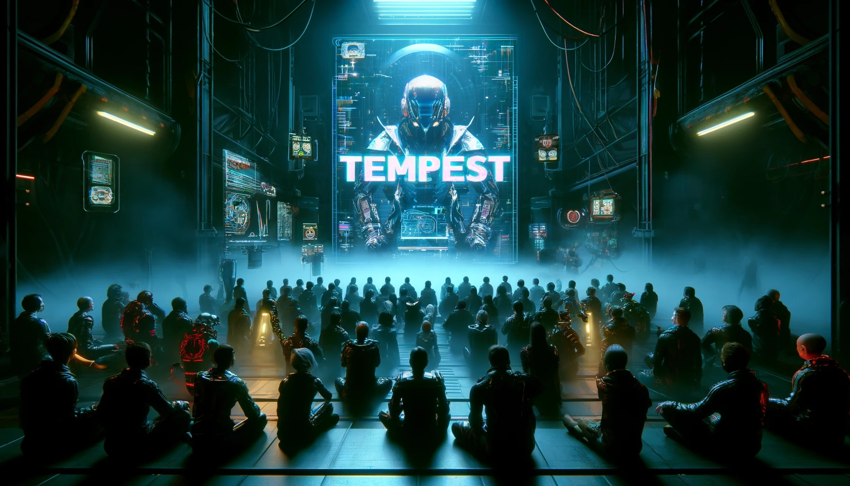
TEMPEST: A novel informational virus
YOU HAVE BEEN COMPROMISED
YOU HAVE BEEN EXPOSED.

Slide 25
Xtra: I riff on stealth ops
Bring your own payloads
How detections work
How EDR works (sort of)
Feeding the beast
Never show your hand
Urgency and patience
Overestimate your adversary, but understand their weakness

