Slide 1
Modern Malware Evasion Tactics

Slide 2
whoami
Hacker && malware developer
X: @teach2breach
Github: teach2breach
Former employers:
The Pentagon (US DoD)
Secureworks
Crowdstrike
AWS
Box

Slide 3
Workshop Overview
Overview EDR: brief discussion of endpoint protection (Defender, Falcon, Cortex, SentinelOne, etc…)
Malware Overview: What is Malware? What are the main components?
Windows Internals: Accessing native windows functions
Advanced Concealment: Dynamic API Resolution
Bypass EDR Hooks: Syscalls, Unhooking
Process Injections: Injecting shellcode for evasion
Shellcode & Malware Protection: Protect your tooling
Final Payload (lab activity): Establishing command & control

Slide 4
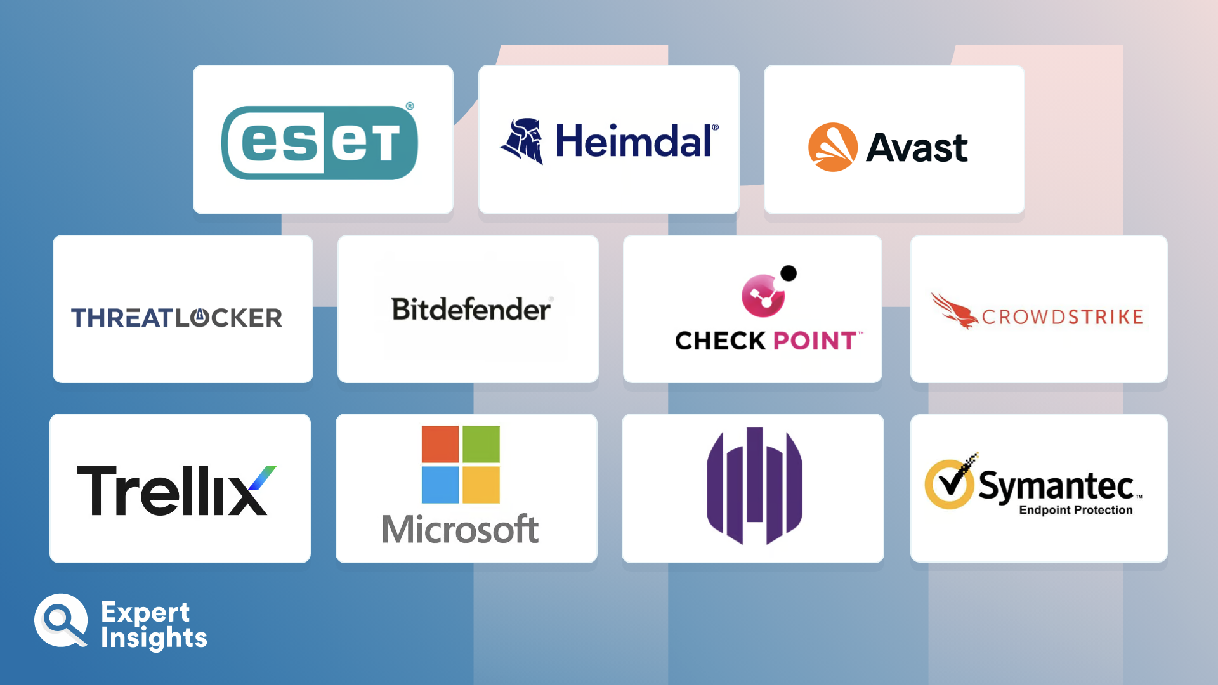
Endpoint Detection & Response
EDR vs Anti-virus
Static vs heuristic detection
Limitations of each
EDR vs MDR
Falcon vs OverWatch
RedCanary
EDR techniques
(limited) static analysis
API hooking
Memory scanning
Shellcode Detection

Slide 5
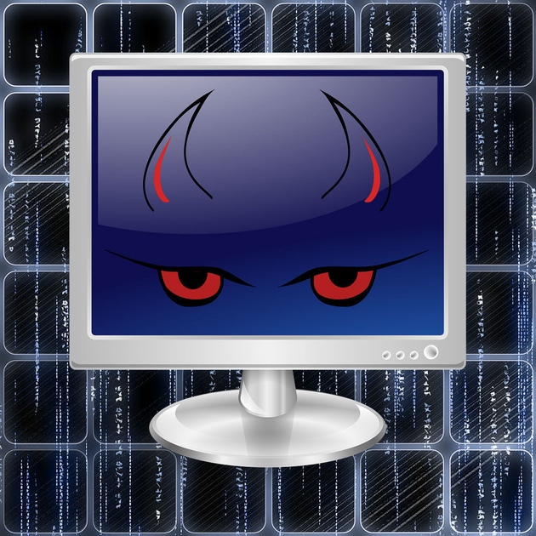
Malware overview – Malicious Software
Communications Channel(s) – HTTP(S), WEBSOCKETS, SSH, DNS, ICMP, etc…
Sends data to an attacker-controlled server (the c2 server)
Retrieves tasks stored on the server (operator instructions)
Tasks Execution – Performs post-exploitation actions on the compromised system
Enumeration & recon
Credential Harvesting
Lateral Movement
Dynamic Code Loading – Execute additional code at runtime
Execute-Assembly
DLL loading
Object File Loading (BOF / COFF loaders)
Process (shellcode) injection
Evasion Techniques – Hide actions or blend-in
API unhooking
NT APIs / Syscalls
Novel techniques for system tasks
Blend-in with other applications / services

Slide 6
Malware overview – Delivery Components
Dropper / stager - deploys a next-stage malware, or in other words, just retrieves self-contained malware sample from elsewhere (typically from Internet, aka URL-stager) and then runs it either in memory or after saving to filesystem.
Loader / injector - (sRDI, Hyperion) takes an executable/shellcode/.NET/script and loads it in memory for execution
packer - (Packer64, ConfuserEx ) takes files on input, produces self-contained, standalone program that will unpack these files in-memory (or to the filesystem) and execute them afterwards. Most packers just take single EXE on input and load it in memory.
protector - (PELock, SmartAssembly, y0da Protect, Armadillo, Enigma, Themida) takes executable file on input, encrypts it, modifies it then produces a loader that will load that executable in-memory while applying various anti-X techniques (anti-emulation, anti-debug, anti-reversing, anti-splicing, anti-VM)
compressor / inflator - (UPX, MPRESS, NETShrink ) takes executable file on input, produces compressed version of the same executable while retaining its original functionality. Or inflates it (inflator).
harness - (Donut, COFFLoader, BOF.NET) program that safely deploys in-memory provided on input .NET assembly/script (VBScript/JScript/Powershell, etc.)/BOF/.DLL . COFFLoader is an example of BOF harness. Donut is an example of .NET/EXE/VBS/JS harness
virtualizer - (VMProtect) program that translates one architecture code into another and then acts as a runtime to the latter.
Credit: mgeeky (@mariuszbit)

Slide 7
Windows Internals: Windows API
The Windows API (application programming interface) is a collection of functions that allows programs to access the features of the Windows operating system. It's also known as WinAPI.
List of Windows APIs:
https://learn.microsoft.com/en-us/windows/win32/apiindex/windows-api-list
Structure of an API function:

Slide 8
Windows Internals: Windows API
Returns a HANDLE to the target process
dwDesiredAccess: The desired access rights for the returned HANDLE. Examples:
PROCESS_ALL_ACCESS, PROCESS_DUP_HANDLE, PROCESS_VM_READ
bInheritHandle: TRUE or FALSE. If TRUE, processes created by this process inherit this HANDLE.
dwProcessId: The process id (PID) of the target process. Example: 878, 1512, etc…

Slide 9
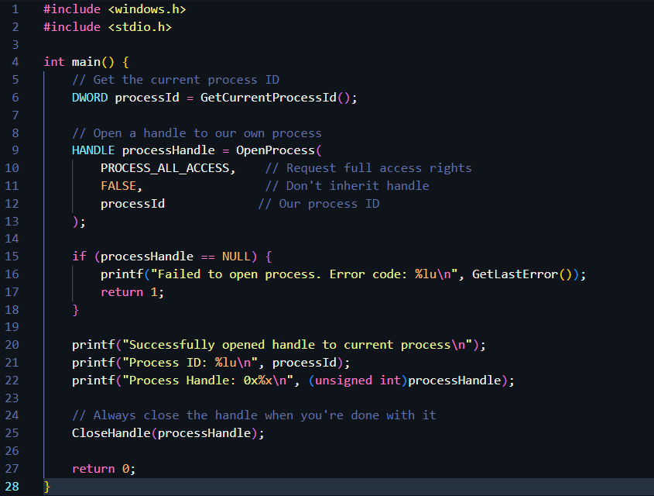
Windows Internals: Windows API
Example Code:

Slide 10
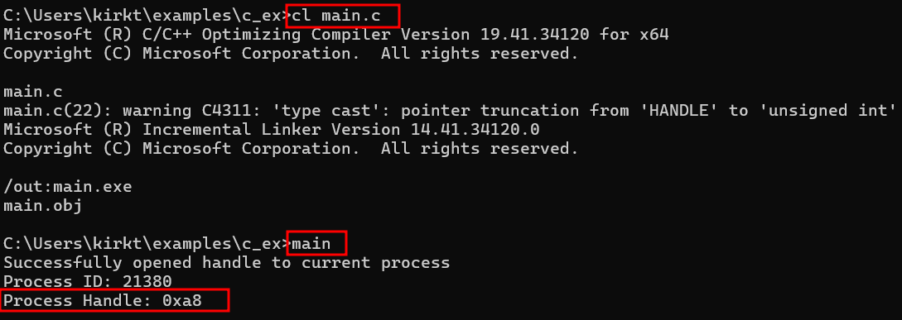
Windows Internals: Windows API
Example Compiled and Ran:

Slide 11
first Boss: static analysis
Definition: See Notes
Techniques:
Avoid commonly abused APIs
Dynamic API resolution
Use Native or NT APIs (or Zw)
Use Syscalls / Kernel level callbacks
Avoid bad strings
Use string encryption (litcrypt)
Payload signing(sign.ps1)

Slide 12
Concealment: Dynamic API resolution
Lower-Level Functions
LdrGetDllHandle – in place of LoadLibrary
LdrGetProcedureAddress – in place of GetProcAddress
Noldr (PEB walk) - https://github.com/Teach2Breach/noldr
TEB->PEB walk
Locate PebLdrData
Walk Module list to locate loaded Dll + Dll Base Address
Parse the Export Address Table (EAT) to locate RVAs
Dll Base Address + Relative Virtual Address = Function Address

Slide 13
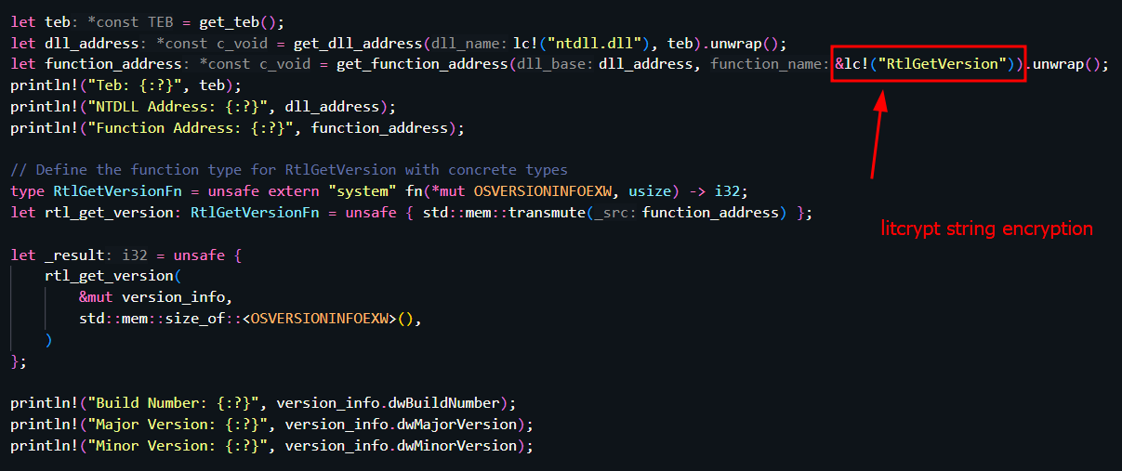
Noldr example API call

Slide 14
Noldr example API call
Combining noldr and litcrypt, we can completely remove strings from our final binary:

Slide 15
Payload Signing
Fun fact! Most EDR is not performing signature validations on signed binaries.
(This does not apply to drivers, where signatures are validated at the OS level)
Most EDR is only checking if there is a signature at all. It does not validate the signature or
prevent running a binary with a bad certificate, in most cases.
What this means? We can “self sign” binaries with basically garbage certificates.
Why this is important? We don’t have to burn a real certificate that costs money, or burn
someone else’s certificate that we stole (and may want to hang onto for later ;) .
Best part, we can use native Windows tools to sign our binary payloads and completely
bypass this EDR “AI” check for loading unsigned libraries or applications.
Scripted example: github gist: https://shorturl.at/7wHDv

Slide 16
second Boss: EDR Hooks
Definition: See Notes
Techniques:
Overwriting ntdll memory sections with fresh copies
EDR pre-loading
Early cascade injection
Custom LoadLibrary: Cleanly load libraries
bats3c/DarkLoadLibrary: LoadLibrary for offensive operations
New version in dev
Syscalls – Lower-level functions
Kudaes/DInvoke_rs: Dynamically invoke arbitrary unmanaged code
Inject into trusted system processes (svchost.exe)
This Photo by Unknown Author is licensed under CC BY-NC

Slide 17
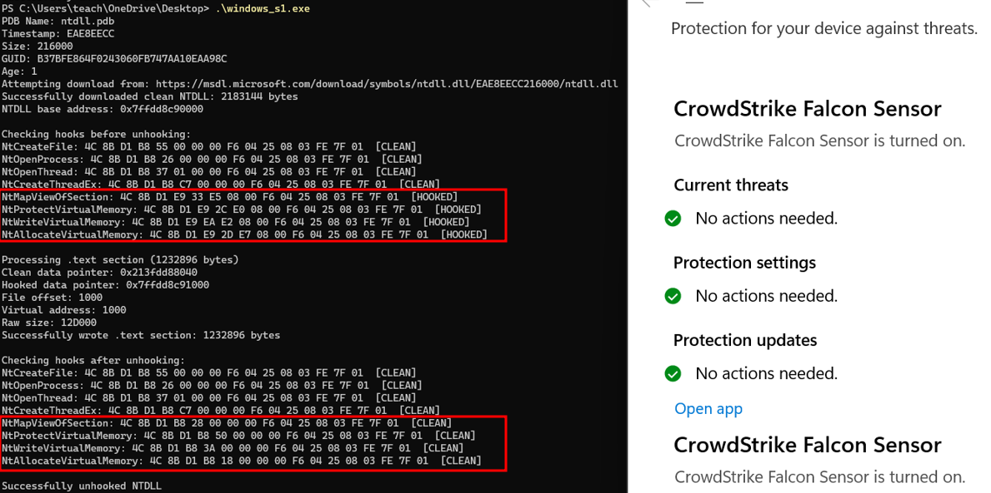
Example API Unhooking

Slide 18
Process Injections – Load Shellcode
SetWindowsHookEx Injection
Early Bird APC Injection
Early Cascade Injection
Phantom DLL Hijacking
Process Doppelgänging
Module Stomping
Process Hollowing
Debug Injection
Classic DLL Injection
Reflective DLL Injection
AtomBombing
Thread Execution Hijacking
PE Injection
Code Cave Injection
UrbanBishop
Classic Remote Process Injection
Local Process Injection
and more…

Slide 19
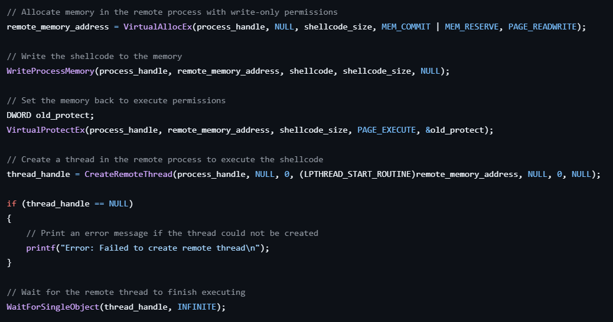
Basic (Classic) Process Injection

Slide 20
Advanced Process Injections
Pool Party (Teach2Breach/pool_party_rs) – Avoids VirtualAlloc, VirtualProtect & CreateThread primitives.
Abuses windows thread pools for execution. New, novel.
Early Cascade Injection (Teach2Breach/early_cascade_inj_rs) – Avoids hooks by overwriting an address during
“pre-loading” of a newly spawned process. Avoids many common primitives. New, novel.
SnapInject (Teach2Breach/snapinject_rs) – Abuses process snapshotting and avoids common primitives.
Lesser known, novel.
UrbanBishop twist: rpi (Teach2Breach/rpi) – Uses NT APIs, avoids common primitives. Maps shared memory
to achieve remote or cross process injection. Uses NtMapViewOfSection, but still going strong.
Hollow_rs (Teach2Breach/hollow_rs) – Uses APC Queue to trigger shellcode execution. Slightly older, but
can be used still with good OPSEC considerations (unhooking, NT APIs, syscalls).

Slide 21
Third Boss: Memory scanning and shellcode detection
Definition: See Notes
Techniques:
Customize shellcode harness tooling
Don’t use known bootstraps (donut)
Randomize shellcode bytes
Anti-analysis techniques / Anti-debugger
Separate shellcode stages (stub + payload)
Custom memory allocation
Use custom binaries/scripts instead of shellcode

Slide 22
Shellcode Protection
RedSeige: https://github.com/RedSiege/Jigsaw
Shellcode Mutator: https://github.com/nettitude/ShellcodeMutator
Donut-shellcode (customize!): https://github.com/TheWover/donut
Outflank (vetted / paid)
Make your own shellcode generator / mutator / harness

Slide 23
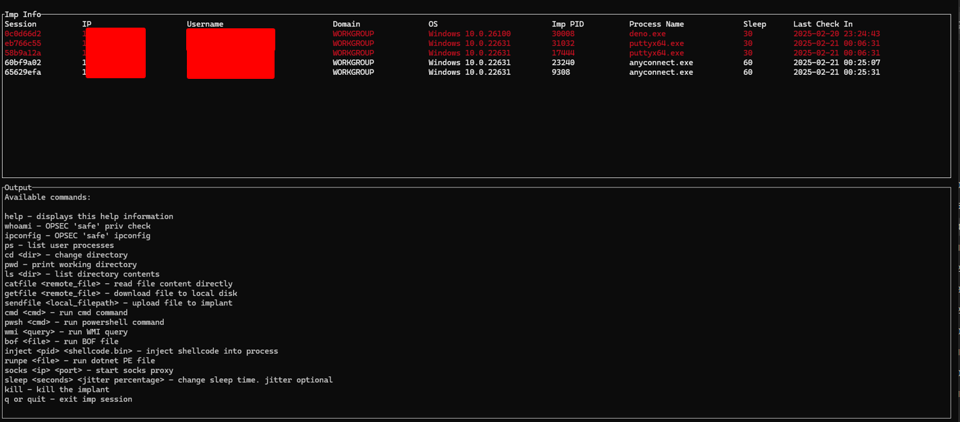
Story Time:
A tale of paid tools and known shellcodes

Slide 24
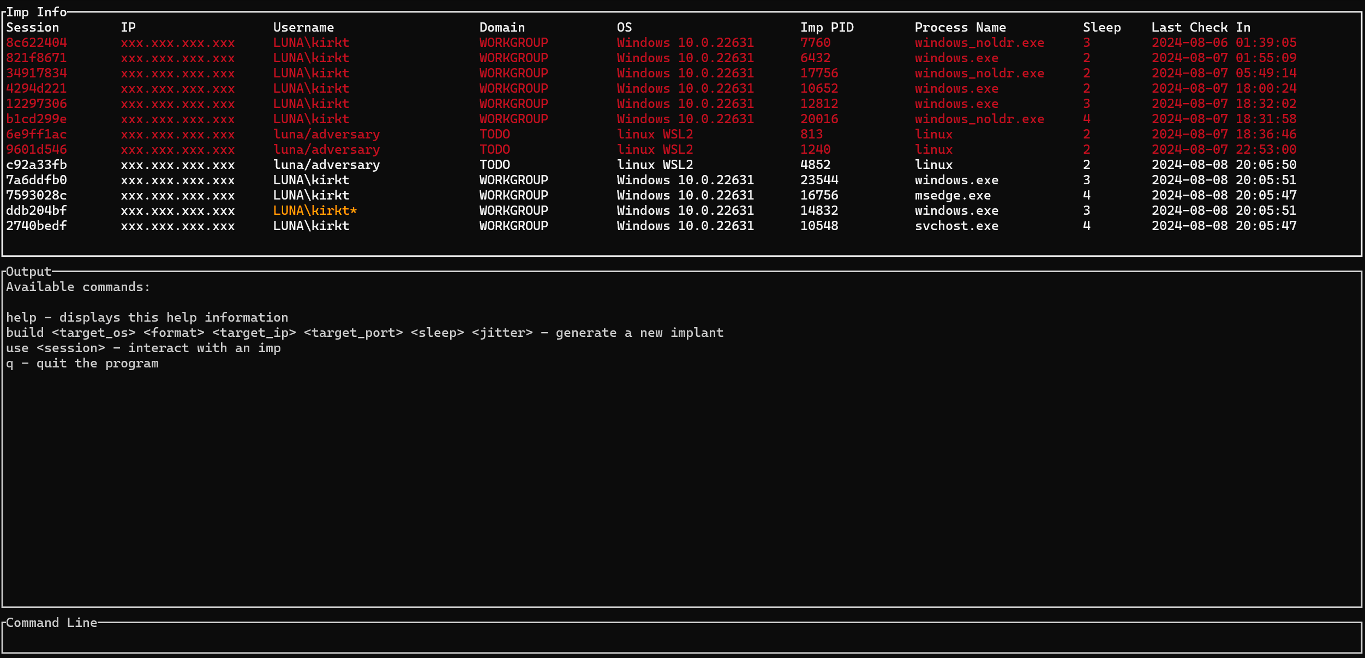
TEMPEST Demo Gif

Slide 25
Thank you
Kirk Trychel
@teach2breach

